Slide 1
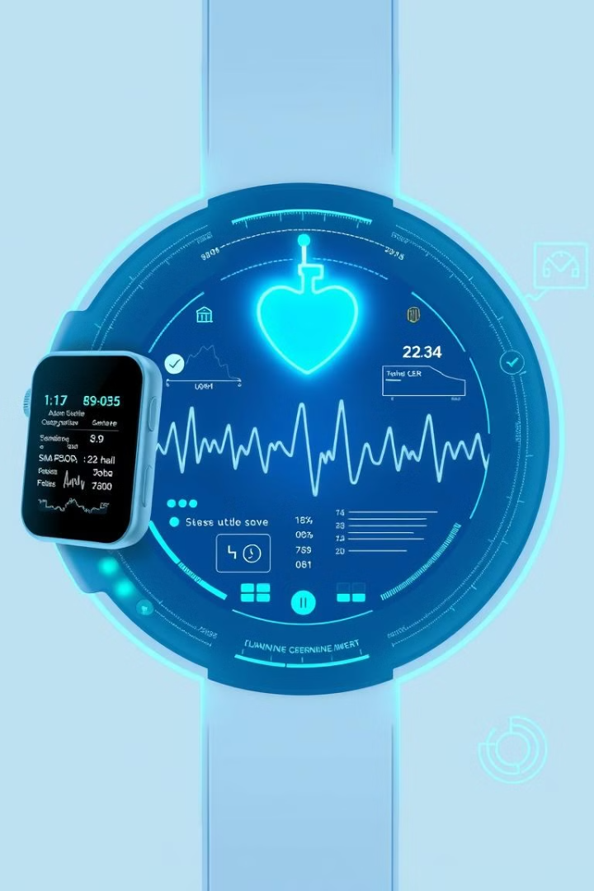
Advance Health Monitoring System

Slide 2

Introduction to the developed
IoT system
The system uses healthcare sensors to monitor patients, like heart rate sensor, blood pressure sensor, ECG sensor. Providing reports through a display and mobile application. It also uses GPS modules for live location and voice alerts and SMS alerts in emergencies.

Slide 3

Functions explained
Calculate heart rate & SPO2 & blood pressure
Calculate Body Temperature & Room Temperature & Humidity level
Detect the falling
Display ECG Wave
Live location share
Emergency sound alert
Emergency Button alert
Sent Alert messages to admin and Hospital
Display vital signs in a mobile app and Web dashboard
Store the vital signs data in firebase

Slide 4
Components used through a BOM
Item Name | Qty | Price
Arduino mega | 1 | 5390
SIM800L | 1 | 1255
OLED 0.96 inch Display | 1 | 780
MAX30100 | 1 | 590
ECG(AD8232) | 1 | 1750
DF-Mini player | 1 | 525
Speaker | 1 | 360
Data cable | 1 | 290
GPS-Module(NEO 6VM) | 1 | 1350
DS18B20(waterproof temp) | 1 | 450
MPU6050 | 1 | 595
Switch | 1 | 75
LM2596 | 1 | 280
Dot Board | 1 | 1350
ESP8266 | 1 | 1570
DTH11 | 1 | 590

Slide 5

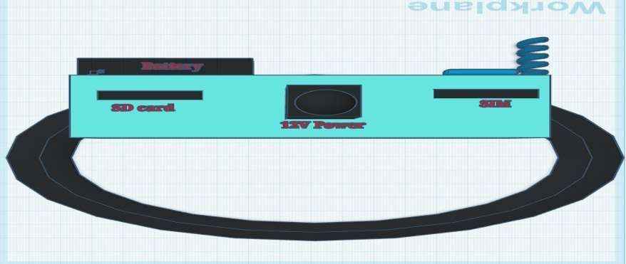
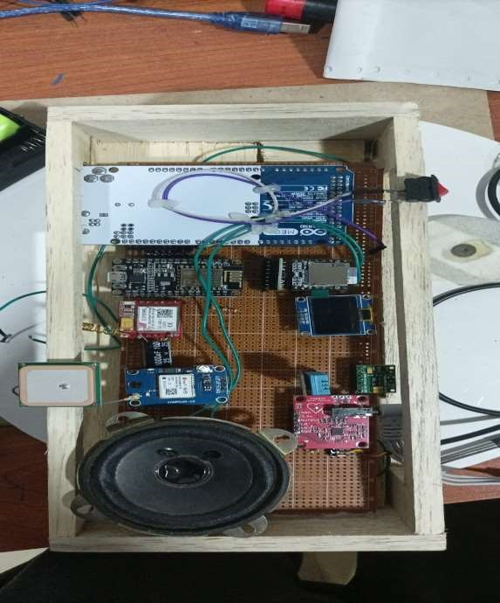
Detailed design (3D modeled or hand drawn sketch)

Slide 6

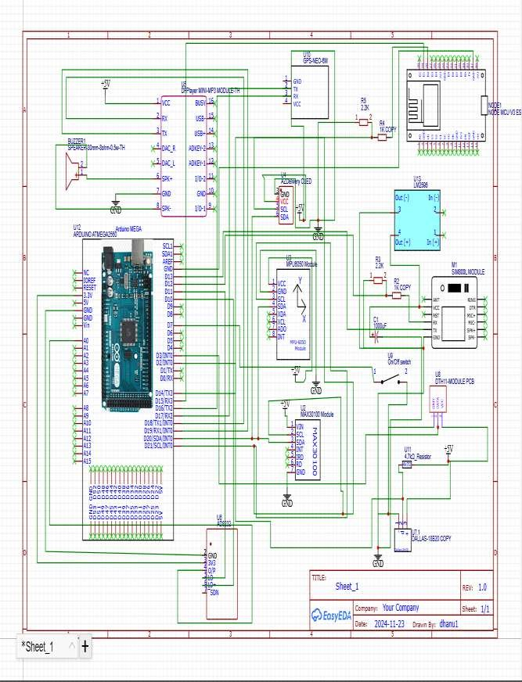
Circuit diagram

Slide 7

Thank You!

Slide 8
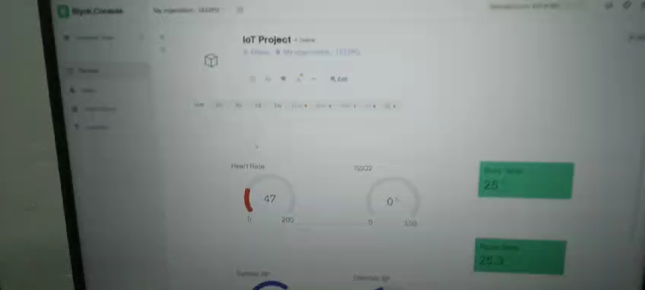

Slide 9
